Slide 1

Access to Fresh Produce in New York City
Applied Data Science Capstone
By Adrienne Meehan
June 2020

Slide 2
Access to Fresh Produce
Reduces risk of obesity and diet-related disease
Access is not equal throughout the United States
New York City very populous, high inequality
Usually related to demographic and economic factors

Slide 3
Data
Foursquare
Venues, Grocery Stores by Neighborhood
Neighborhood Tabulation Areas (NTA)
New York City’s definition of Neighborhoods with geographic boundaries
American Community Survey 5-year estimates
Economic and Demographic data by NTA

Slide 4
Venues Categorized as Having Fresh Produce
Grocery Store
Supermarket
Farmers Market
Fruit & Vegetable Store
Organic Grocery
Health Food Store
Deli/Bodega.

Slide 5
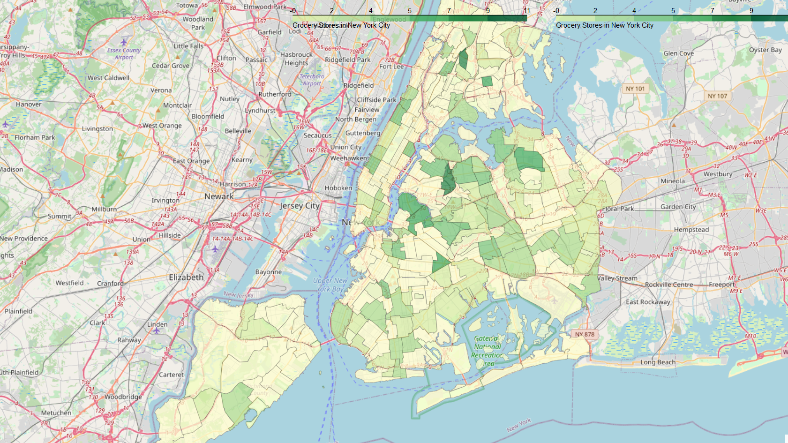

Slide 6
ACS Predictors for Number of Grocery Stores
Predictors
the percentage of the population identifying as Hispanic
the percentage of the population identifying as Black, Non-Hispanic
median household income
the percentage of the population utilizing SNAP benefits
the percentage of the population below the poverty level

Slide 7
Models Using ACS Data
Model | Accuracy
Multiple Linear Regression, Non-Normalized | R² = 0.134
Multiple Linear Regression, Normalized | R² = 0.080
K Nearest Neighbors | Test Accuracy = 22%

Slide 8
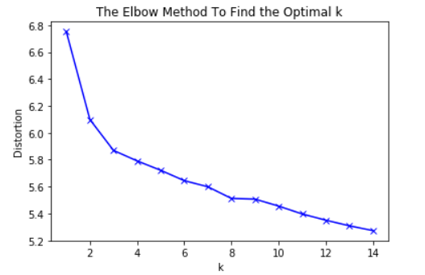
K-Means Clustering
Use K = 8 based on elbow method
Cluster based on most popular venue category in each neighborhood

Slide 9
K Means Clustering Results
Cluster | Primary Borough | Top Categories | Mean Grocery Store | Minimum Grocery Store | Maximum Grocery Store
0 | Bronx | Pizza, Pharmacy | 1.8 | 0 | 4
1 | Manhattan | Park, Playground, Coffee shops | 2.0 | 0 | 6
2 | Manhattan | Asian Restaurants | 4.3 | 1 | 6
3 | Manhattan | Coffe shops, Cocktails | 2.8 | 1 | 7
4 | Queens | Bar, Bank, Bakery | 6.0 | 3 | 11
5 | Bronx | Pizza, Pharmacy | 3.9 | 1 | 9
6 | Queens | Italian Restaurants, Women's Stores, Entertainment | 0.7 | 0 | 3
7 | Manhattan | Italian Restaurants, Coffee, Cocktails | 3.0 | 1 | 9

Slide 10
